Slide 1

Creating Enhancements to improve learner’s studying experience for Monash’s micro-credential course
ETC5543 Internship presentation
Dang Thanh Nguyen - 31278213

Slide 2
Table of Content
Introduction
Background
Motivation
Objectives
Contributions
Limitations
Assets Developed
Asset 1: Functions
Asset 2: R Operators, Syntax, Shortcuts
Asset 3: Git and GitHub functionality
Asset 4: Sample assignment
Asset 5: KNN imputation and survivorship bias
Asset 6: Word Cloud
Conclusion

Slide 3

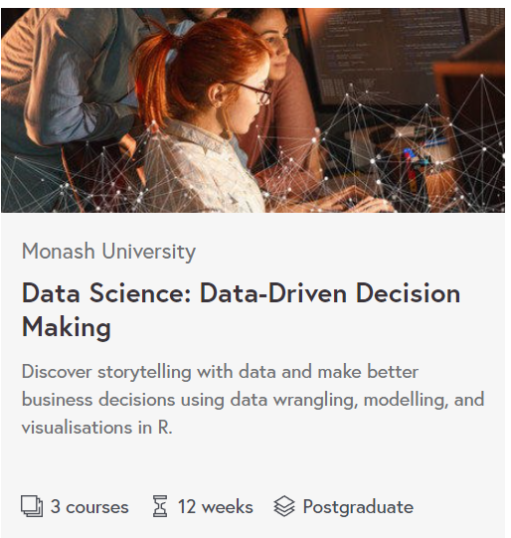
Introduction

Slide 4
Introduction
Objectives:
1 . Common Objective:
The assets were crafted with the nature of micro-credential in mind. All the assets are related to the concepts and learning outcomes of their respective course. Furthermore, The assets need to maximise user experiences. combine graphs).
2. Specific objectives:
Creating well-documented and well-explained assets that support new learners with no background in statistics and R-coding.
Delivering cutting edges techniques that learners can apply in solving problems.
Providing detailed examples and code that learners can duplicate in their work.
Supplying functional practices that can improve learners’ productivity.

Slide 5
Introduction
Contribution
The author crafted enhancements that fill the gap in pre-existing material, thus improving the value of the micro-credential.
The author combine learner’s feedback with his own personal experience in learning R to deliver unique written and media materials. These are valuable properties for the course that will assist learners in gaining the skills that they need to apply for their roles.
Limitations
The assets and enhancements created in this have a number of limitations:
The material can not be applied immediately. This may prove troublesome, as the author may not be available in the time period when the changes occur and helps are needed.
Given the nature of micro-credential online course, feedback on the material will not come until June, 2022. This make improving the assets any further can be a problem as the author is not employed to work in that time period.

Slide 6
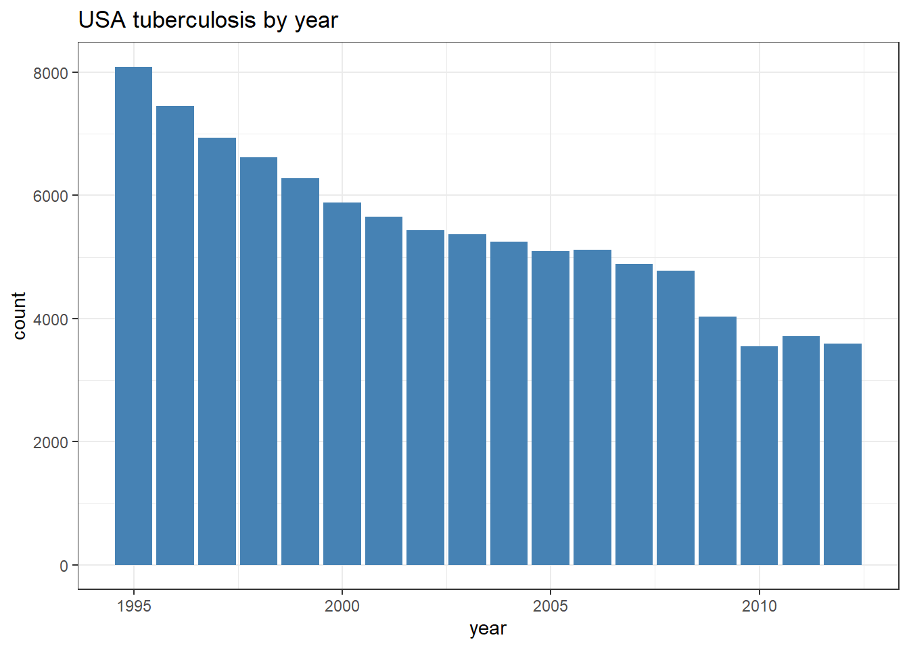
Asset 1: Function
Existing Material:
Function is introduced to learners as a tool for to solve statistics problem. However, there are gaps:
Learners’ studying experience.
- Inefficient content.
Enhancements:
- Introduce function as tools to avoid repetition.
- Improve User’s Experience.

Slide 7
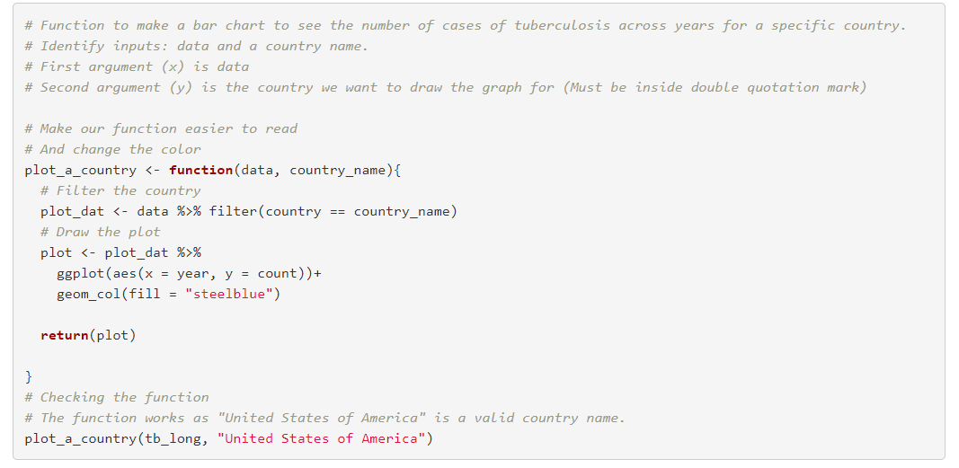
Asset 1: Function

Slide 8
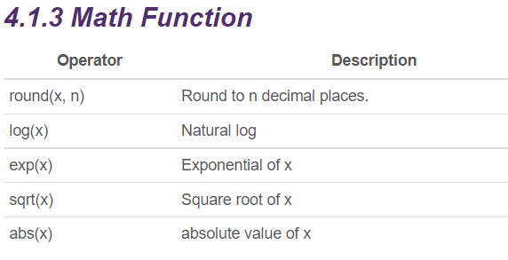
Asset 2: Reading on base R, R synxtax, and Knitr
Existing Material:
Mention of base R, R syntax, operator are scattered everywhere.
No information on R shortcut and Knitr code chunks option.
Enhancements:
- Provide tables for operators, syntax and shortcuts.
Introduce learners to base R syntax.
Introduce learners to chunk’s options in knitr

Slide 9
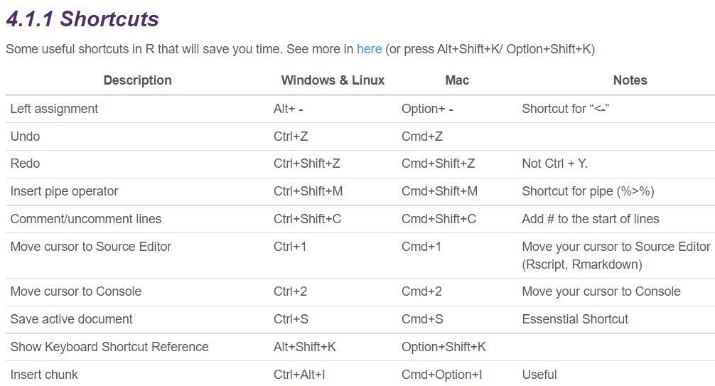
Asset 2: Base R, R synxtax, and Knitr

Slide 10
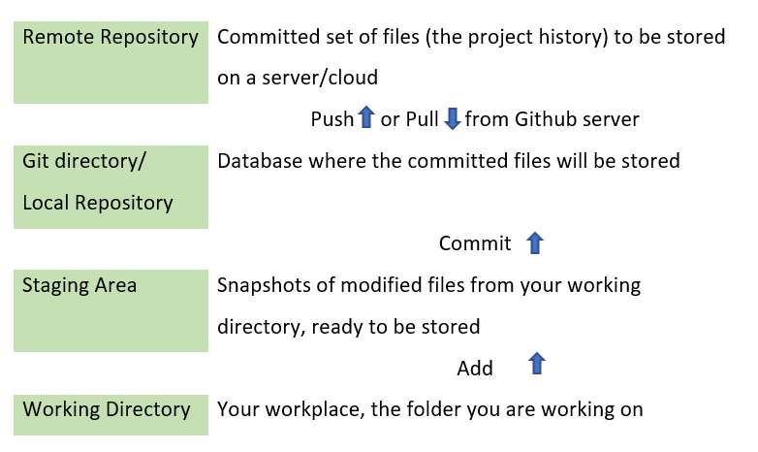
Asset 3: Git and GitHub functionality
Existing Material:
Mention of setting up Git and Github.
No information on how to use Git and Github studio terminal in R.
Enhancements:
Introduce learners to Git and Github workflow
Introduce learners to git commands to interact with GitHub using the Terminal.

Slide 11
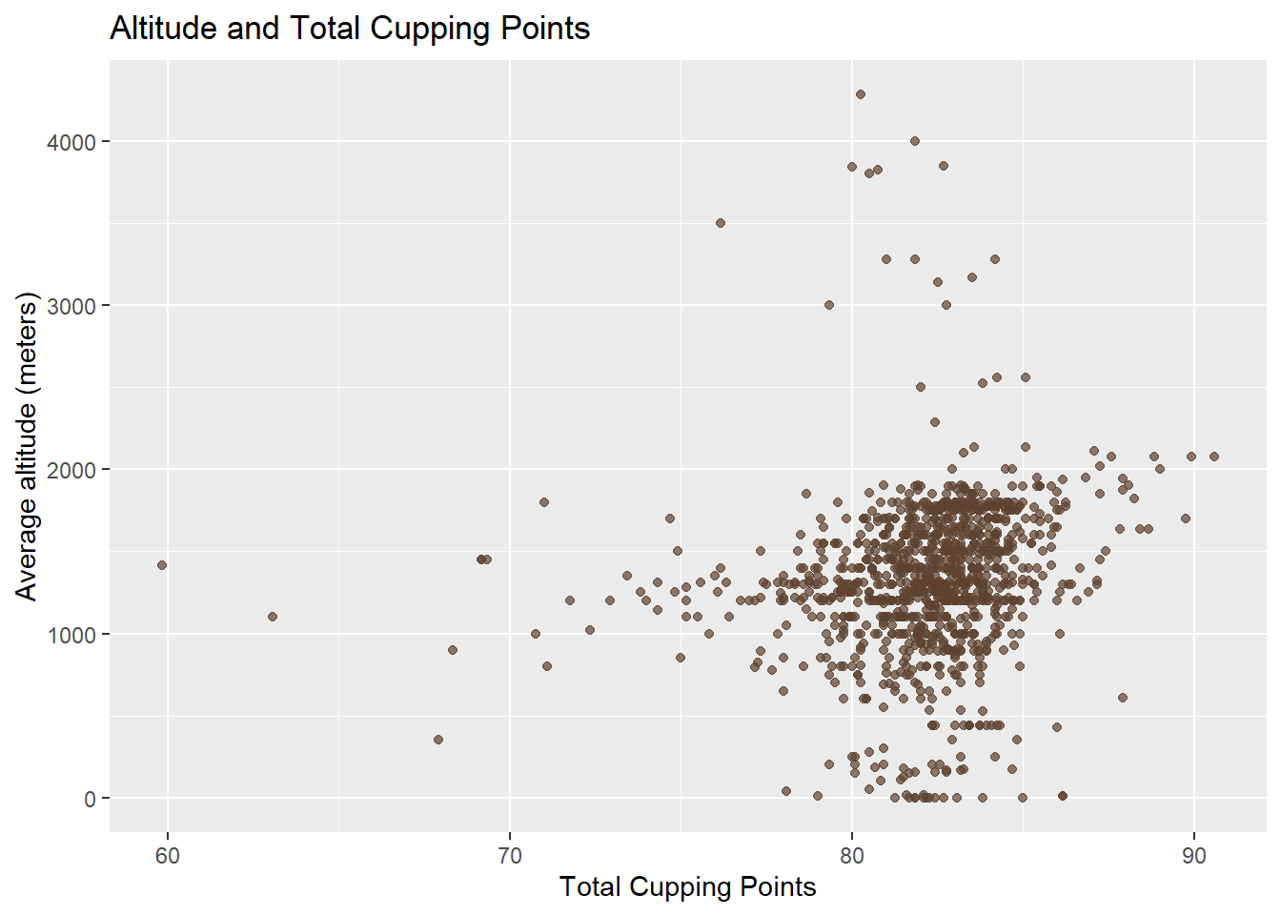
Asset 4: Sample Assignment
Existing Material:
No existing material. There need to be an example that helps learners .
Enhancements:
Provide assignment examples with a nice flow and well-structured sections.
Provide code chunks that only use functions and knowledge covered by the first course.
Provide well-documented code which and have high production values.

Slide 12
Asset 5: KNN-imputation
Existing Material:
- Package in use (Bioconductor) is outdated and hard to install.
- Code is poorly-documented and hard to follow.
Enhancements:
- Highlight the problems of missing values in real life.
- Replace the old knn imputation method with a more advanced tidymodels approach.
- Provide a better explanation and more documents for code chunks,
- Provide discussion for KNN- imputation result.

Slide 13
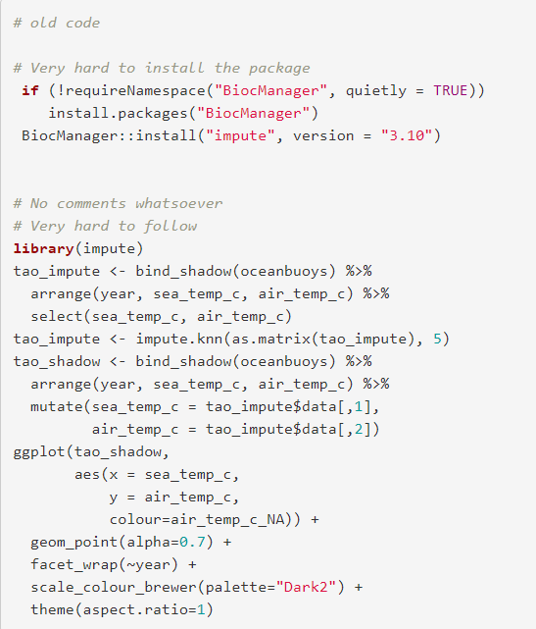
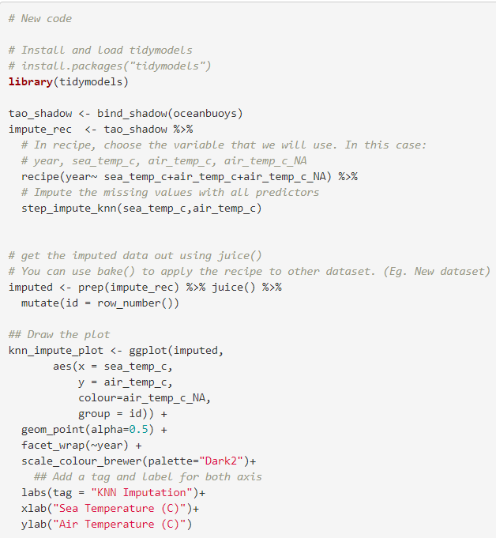
Old Code
Replacement Code

Slide 14
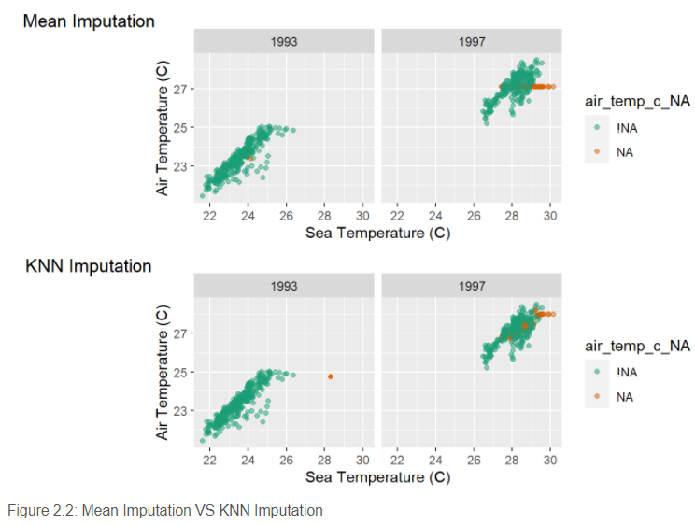
Discussion of KNN-imputation result
The imputed values are closer to the complete case values in both methods. However, for the mean imputation method, the data points form a rigid line, mismatching the variation. They also extend outside the range of complete values. For the KNN method, the values blended well with the complete values. There is still a rigid line that extends outside of the range of complete values in KNN imputation. This can happen if all of the points missing on air temp (ones with high values on sea temp) have the exact same nearest neighbours. If we increase k, to add more nearest neighbours, eventually the line should break. However, there are multiple missing at extremes of sea temp so the line is probably as good as can be done by nearest neighbours.
There is a problem: the imputed air temperature value for these high sea temperature cases is lower than expected for both mean imputation and KNN imputation. There is also an outlier in 1993 for KNN imputation. It is suspected that this point should be a 1997 record and there has to be an error in the data. These findings may possibly impede good model fitting.

Slide 15
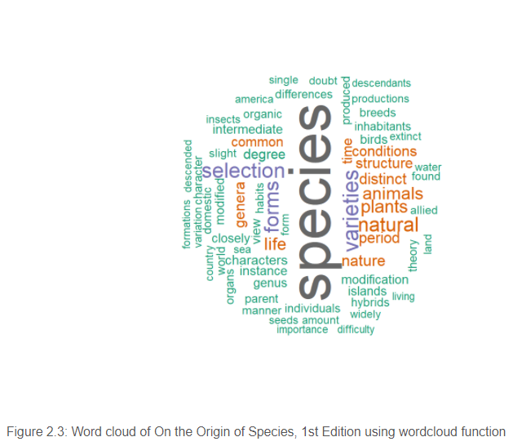
Asset 6: Word cloud
Existing Material:
No existing material. Although word cloud is simple and popular type of visualization.
Enhancements:
Introduce learners to 2 ways of drawing word cloud in R.
Provide codes, comments and discussion for graphs created

Slide 16
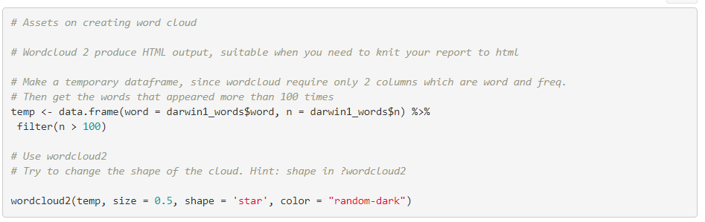
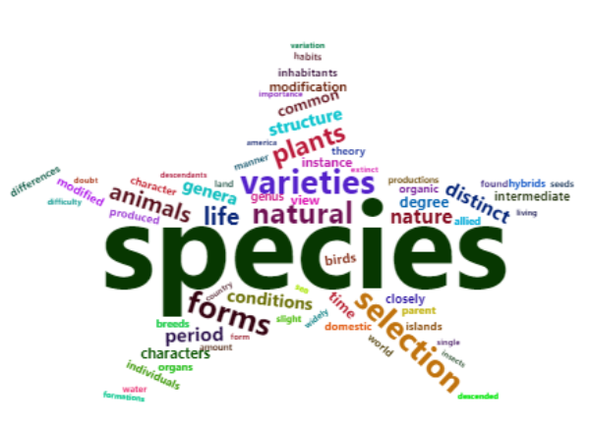
Asset 6: Word cloud
From both word clouds, we can see that “species” appeared the most frequently. It was used far more often than other common words, such as varieties, selection, forms, … It seems like the book focus mostly on the natural world and the variation and selection of species. There seems to be a large focus on plants, and a smaller focus on animals such as birds and insects. It is interesting to note that the words related to geology, such as “land,” “water” and “sea” did not appear much. Besides, it is a surprise that “genetic,” a very important field of evolution theory, did not even appear on the word cloud.

Slide 17
Conclusion
In conclusion, all of the assets created by the author satisfied the pre-identified common objectives and specific objectives. The material follows strictly the goals of micro-credential: To assist learners in gaining the skills that they need to apply for roles as a data scientist or use the knowledge gained to enhance their current organisation. The author combines his own experience in learning R and a focus on learners’ studying experience to deliver unique written and media materials. These materials are valuable properties for the course that will improve the quality of teaching and the learner’s studying experience.

Slide 18
Thank you for listening

